Slide 1
Aim: When do world conflicts affect us?
In what ways can conflict around the world affect you?

Slide 2
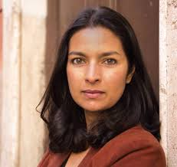
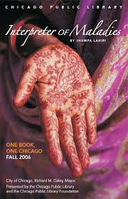
Jhumpa Lahiri born in 1967 in London but grew up in Rhode Island
She recalls how she felt out of place in school because she was different
When Mr.Pirzada Came to Dine is an excerpt from her book of short stories, The Interpreter of the Maladies

Slide 3
Theme:
The central Idea of a story.
Identity
assimilation
Setting:
the locations invovled or discussed

Slide 4
Summary
A young girl named Lilia remembers Mr. Pirzada’s evening visits to her home. Mr. Pirzada had left his family in East Pakistan to write a book on foliage in the United States.
While he was gone, a war started in his country, so he feared for the safety of his wife and seven daughters. Through his visits, Lilia learns many things.

Slide 5
Background
After ruling India for almost two hundred years, the British agreed to a transfer of power in 1947.
The Indian subcontinent then was divided into Pakistan and India.
Muslim minority demands separate state
predominantly Muslim Pakistan
predominantly Hindu India
violent killings; displacement of millions of people

Slide 6
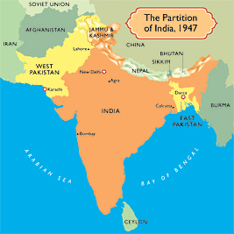
Pakistan itself was divided into two geographically, ethnically, and linguistically separate parts.
Other than sharing a common religion, the people of East Pakistan and West Pakistan had little in common. They spoke different languages and had different cultures, traditions, and physical traits.

Slide 7
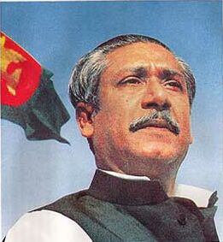
When Mr. Pirzada Came to Background
By the autumn of 1971, when this story takes place, Pakistan was engaged in civil war.
East Pakistan, led by Sheikh Mujib Rahman, was demanding independence.
The West Pakistan government reacted with brutal force, driving ten million refugees into India.

Slide 8
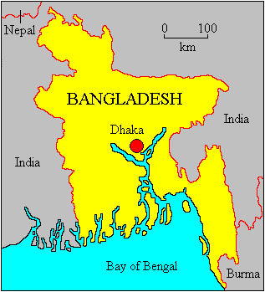
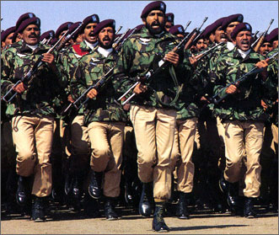
India intervened, quickly forcing the Pakistani army to surrender.
In mid-December 1971, Bangladesh, the former East Pakistan, was established as an independent state.

Slide 9
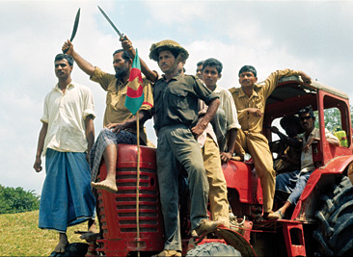
It is 1971, and Pakistan is caught up in civil war.
Lilia is a ten-year-old girl living near Boston.
Her parents, who are from India, befriend a visitor from East Pakistan and regularly invite him for dinner.
As Mr. Pirzada becomes more important to Lilia, the events in far-off Pakistan also become more real to her.

Slide 10
Vocabulary
Ascertain: to find out definitely
Autonomy: to self rule
Foilage: clusters of leaves and branches
Partition: to separate; to become independent
Austere: very simple; without decoration
Impeccably: without error; without flaw

Slide 11
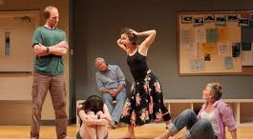

Slide 12
Today’s task
Main Character Analysis
Drawing Conclusions

